Slide 1
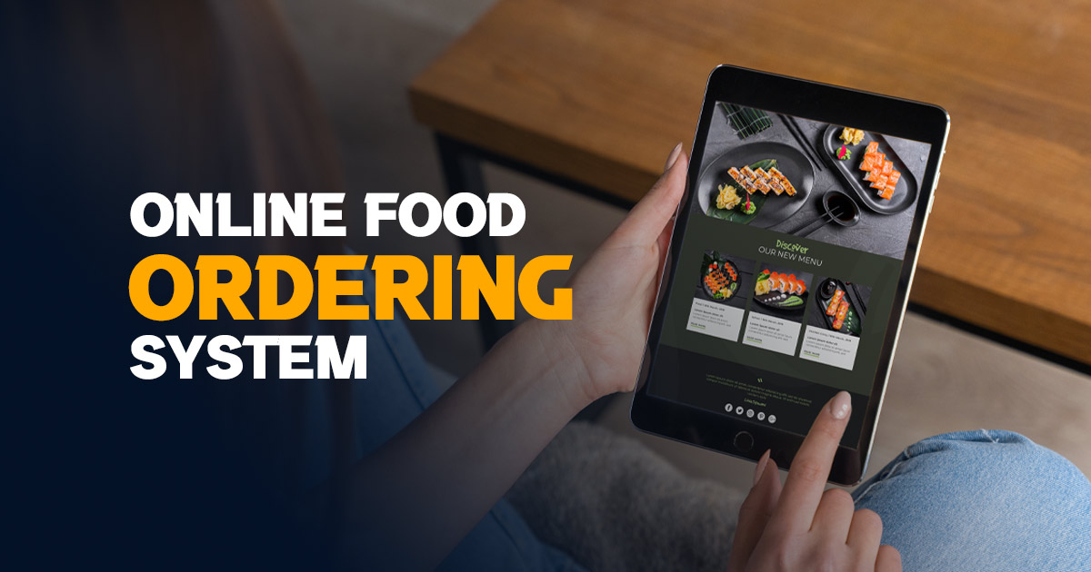
Feast Express
By: Anusree Ravichandran, dated: 11/09/2024

Slide 2

Aim of the Project
This project aims to develop an online food ordering system where customers can select menu items, place orders, and choose payment methods. It incorporates OOP principles like abstraction, encapsulation, inheritance, and polymorphism for a seamless process. Goals of this project are:
Provides an interactive food ordering experience
Flexible payment options
Discount mechanism for prime members or high-value orders
User role-based functionality

Slide 3

business problem /
problem statement
This project solves the need for a efficient online food ordering system that simplifies order placement and provides flexible, secure payment options. Restaurants and food delivery services struggle with manual order processing, managing discounts, and offering multiple payment methods while ensuring customer satisfaction.

Slide 4

project description
SCOPE: This project automates the online food ordering process for restaurants and delivery services, streamlining customer orders and payments.
OBJECTIVES: To Automate Order Process, facilitate Multiple Payment Options, Personalization & OOP Principles Demonstration.
KEY FEATURES:
Menu browsing, order placement, and discount calculation.
Flexible payment options with secure processing.
Personalized discounts for prime members and large orders.

Slide 5

functionalities
Welcome Message: Greeting the user prior to order process.
Role-based Access: System provides access only to "Customer" or denies the access for "Admin.“
Customer Information Collection: Categories the user, to personalize the experience and determine if a discount should be applied or not.
Menu Display: System displays a list of available food items along with their prices.
Order Placement: System tracks the items and calculates the total
running cost.

Slide 6
functionalities (Continued)
Order Summary and Discount Application: Total order value exceeds a certain threshold (Rs 1200) or if the customer is a Prime Member, 30% discount or 40% discount is applied to the total amount.
Payment Method Selection: Users can choose from three payment methods: Debit Card, Cash on Delivery (COD), or UPI Payment.
Order Completion: Ensures the customer has clarity about the order status.
Error Handling: The system includes basic error handling for
invalid menu item selections and incorrect payment
choices, ensuring a smooth user experience even
in case of incorrect input.

Slide 7

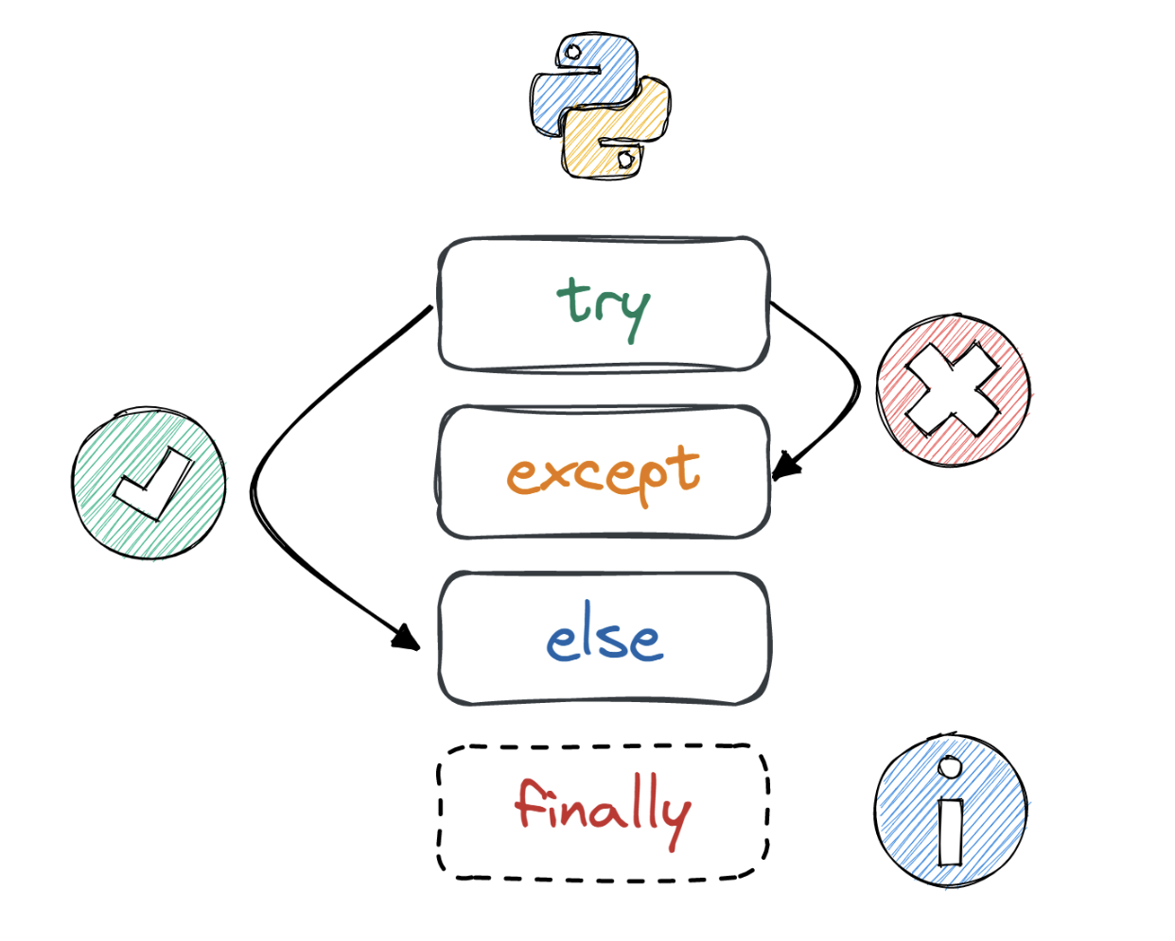
input versatility with
errors and exceptions
User Role Input: Displays an error message for non-customers or Admins for ordering food
Food Item Selection: Users input food items being converted to title case for consistency. Invalid entries prompt an error message, and the process continues until "done" is entered to finalize the order.
Prime Membership Status: When prompted the user responds to "yes" or "no" option, the system checks for appropriate discounts based on total cost attributes.
Payment Method Input: Users select a payment method by entering a corresponding valid number, and the system defaults to Cash on Delivery (COD) if the entry is invalid.
Error Handling: The project handles common input errors with conditional checks but does not explicitly manage exceptions like invalid data types or unexpected inputs.

Slide 8
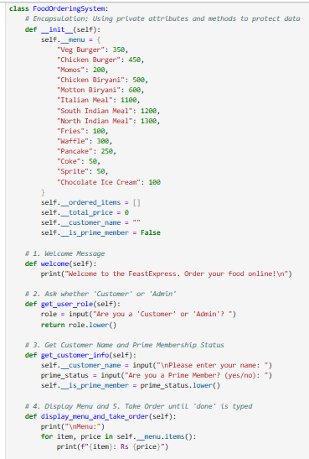
code implementation
Food Ordering System:
Implements Encapsulation
Ensures Data Integrity
Protects Sensitive Information
Payment Method:
An abstract base class which implements Abstraction Methodology
DebitCardPayment, CODPayment, UPIPayment
Implements Inheritance & Polymorphism

Slide 9

results & outcomes
Results Achieved:
Streamlined Ordering Process
Flexible Payment Options
Discount Application
Error Handling
Insights Gained:
OOP Principles in Action
User-Centric Design

Slide 10

conclusion
Key Points:
Automated Ordering: Simplifies food ordering process.
Flexible Payments: Supports debit cards, cash and UPI payments.
Discounts: Applies discounts for prime members and high-value orders.
Significance:
Efficiency: Streamlines the ordering process, improving user experience and operational efficiency.
Future Developments:
Integration with Payment Gateways: For real-world payment processing.
Admin Features: To manage menu items and monitor orders.
Enhanced Error Handling: For robust input validation and exception management.

